Slide 1

The Business of Plant Breeding:
Market-led approaches to new variety design in Africa
The Business of Plant Breeding:
Market-led approaches to new variety design in Africa
Executive Summary

Slide 2
Overview
Principles of demand-led plant variety design
Visioning and foresight for setting breeding goals
Understanding clients’ needs
New variety design and product profiling
Variety development strategy and stage plan
Monitoring, evaluation and learning
Making the business case for investment in new variety development

Slide 3
1. Principles of demand-led plant variety design
Objectives
To understand the current status and challenges facing African agriculture
To review modern variety adoption in Africa
To understand the principles of demand-led breeding and similarities and differences with current practices

Slide 4
Transformation of Africa’s agriculture
Africa’s agriculture is at a tipping point; moving from subsistence systems to more market-led systems
Smallholder farmers are generating surpluses of products to sell in local, national, regional and international markets
Demand for products is rising with population growth, urbanization and changing lifestyles
A new breed of consumers – focused, choosy and ready to pay for quality and safety of food

Slide 5
Transformation of Africa’s agriculture
Enabling small scale farmers to access the expanding markets is a critical challenge facing policy makers
Participation of smallholders in markets requires:
  Identification of market demands
  Developing products with suitable characteristics to meet market requirements

Slide 6
New Variety Adoption in Africa
DIIVA study by Walker et al (2014) shows about 35% adoption of new varieties of 20 crops in 30 African countries over previous 15 years
Compares with average of 60% new variety adoption in Asia and 80% in Latin America

Slide 7
Adoption of Modern Varieties of Food Crops in Africa
Crop | Country observations | Total area (ha) | Adopted area (ha) | % MVs
Soybean | 14 | 1,185,306 | 1,041,923 | 89.7
Maize–WCA | 11 | 9,972,479 | 6,556,762 | 65.7
Wheat | 1 | 1,453,820 | 850,121 | 62.5
Pigeonpea | 3 | 365,901 | 182,452 | 49.9
Maize–ESA | 9 | 14,695,862 | 6,470,405 | 44.0
Cassava | 17 | 11,035,995 | 4,376,237 | 39.7
Rice | 19 | 6,787,043 | 2,582,317 | 38.0
Potatoes | 5 | 615,737 | 211,772 | 34.4
Barley | 2 | 970,720 | 317,597 | 32.7
Yams | 8 | 4,673,300 | 1,409,309 | 30.2
Groundnut | 10 | 6,356,963 | 1,854,543 | 29.2
Bean | 9 | 2,497,209 | 723,544 | 29.0
Sorghum | 8 | 17,965,926 | 4,927,345 | 27.4
Cowpeas | 18 | 11,471,533 | 3,117,621 | 27.2
Pearl millet | 5 | 14,089,940 | 2,552,121 | 18.1
Chickpea | 3 | 249,632 | 37,438 | 15.0
Faba bean | 2 | 614,606 | 85,806 | 14.0
Lentils | 1 | 94,946 | 9,874 | 10.4
Sweetpotato | 5 | 1,478,086 | 102,143 | 6.9
Banana | 1 | 915,877 | 56,784 | 6.2
Field peas | 1 | 230,749 | 3,461 | 1.5
Total/weighted average | 152 | 107,721,630 | 37,469,577 | 34.78

Slide 8
Variety Adoption in Africa
Constraints and issues in low adoption
  Awareness
  Availability
  Profitability
Measuring adoption levels
  Pros and cons of various methods
  Quality of data is the key requirement
  Expert opinion, focus groups and survey data

Slide 9
Breeding Goals and Objectives
Trait trade-offs
  Categorize and rank priority traits
Categories of traits
  Plant traits; Tolerance to abiotic and biotic stresses;
  Consumer/market preferred traits;
  Balance of traits i.e.
Basic traits all varieties must have;
Traits to increase market share; and
New traits not available in existing cultivars

Slide 10
Principles of Demand-Led Breeding
What is demand-led plant breeding?
Demand-led breeding is an approach that enables plant breeders to develop higher performing varieties that meet customer requirements and market demand
It is based on six core principles
Client Preferences
Value Chain
Market Research
Market Trends and Drivers
Integration
Multi-disciplinary

Slide 11
Demand-led Breeding goes beyond Participatory Plant Breeding
Participatory Plant Breeding
demand-led breeding
Highly localised activity
End products are designed to suit specific environments
The key actors in PPB are the farmers and the breeders
PPB focuses on local needs, largely in subsistence food systems
PPB focuses on local practises and harnesses expertise of farmers and breeders
Seed distribution in PPB is limited to the locality of its operations
Broader in scope and targets large areas or agro-ecological zones where the crop can be produced at national, regional and global levels
Targets all actors in a value chain and innovation system
Emphasizes markets, their demands, trends, and uses a broad range of tools such as market research, modern product promotion tools and value addition
Seeks to combine the best practises from both public and private sectors
Aims to disseminate seed of new varieties widely within national borders, regionally and globally

Slide 12
Summary
Demand-led approaches aim to make the business of plant breeding in Africa more responsive to market demands
Demand-led approaches go beyond farmer participatory breeding approaches to inclusivity of all the key stakeholders in the value chain
Demand-led breeding retains emphasis on the value of the breeders’ eyes and experience

Slide 13
Summary
An appropriate balance is required between using demand-led approaches and technology/innovation push to maximise market creation for new varieties
Role of plant breeders is much more than just leading crossing or selection programmes
The breeder must also be an integrator of inputs and be able to take on board information from a broad range of sources, including non-technical experts

Slide 14
2. Visioning and foresight for setting breeding goals
Objectives
To empower plant breeders and R&D leaders to consider future agricultural landscapes in Africa
2. To equip breeders with methodologies to design new varieties that will remain relevant and satisfy market demands over time
3. To identify drivers that may affect whether farmers adopt new varieties in the future

Slide 15
Africa at a Glance:
Agricultural landscape
Food supply vs. demand
Demand growth is fastest in the world
SSA population c. 800 million
220 million undernourished
Mean population growth in SSA is c. 3%
(-ve Europe, 0.5% Rest of the World)
Population size expected to double in 35 years
Population growth is double in urban vs. rural areas
Demand

Slide 16
Reasons for the Low Productivity
Input market constraints
Seed laws/industry
local fertilizer industry
Distribution system
Credit availability
WEAK PRIVATE SECTOR
Poor access to markets (lack of access to resources/inputs)
Rapid Urbanization growth (lack of access to land, degradation of natural resources
Low investment in agricultural research, training and extension services
Agricultural constraints
Infrastructure; land rights
African crop diversity/uniqueness
Lack of extension/various farming system
Lack of storage
Overall constraints
War; corruption; governance; education; lack of country economies of scale
Low inter-regional trade
Highest Tariffs
Source:
J L Shoham

Slide 17
Strategies for Transforming African Agriculture
Improving agricultural productivity
Availability and widespread use of quality farm inputs and technologies, including crop biotechnologies
Facilitating growth in agricultural markets and trade
Investing in public infrastructure for agricultural growth
Reducing rural vulnerability and insecurity
Improving agricultural policy and institutions
Foresight and visioning to meet market/consumers’ demands
Notes:
Introduction to unit 2 is very long

Slide 18
Integrating foresight into new variety design
Foresight methods are used to review existing variety designs or as a starting point to create new designs
Every trait characteristic in each product profile should be analysed and a decision taken if the trait and benchmark is likely to remain relevant over time required for variety development

Slide 19
3. Understanding clients’ needs
Objectives
1. To equip breeders with the knowledge and methods to understand clients and their value chains, their needs, what they prefer and are prepared to pay for in a new variety
2. To understand markets and the need, importance and principles of market research and best practices to guide the information gathering from clients and crop value chains to drive and validate new variety designs

Slide 20
Understanding Clients’ needs
Crops and their Uses
Clients and Stakeholders
Markets and Market Segments
Clients within Value Chains
Understanding Markets and Market Research

Slide 21
Simplified Tomato Value Chain in Ghana Market Segments
Seed producers/
suppliers
Local seed producers/farmer saved seeds (informal)
Farmers
Market Queens
Retailer
Open market
Roadside grocery
Supermarkets
Consumers
Hotels & Restaurants
Local households
Expatriates

Slide 22
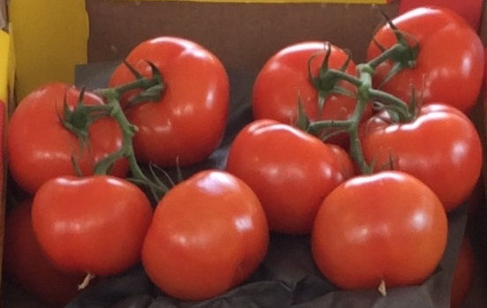

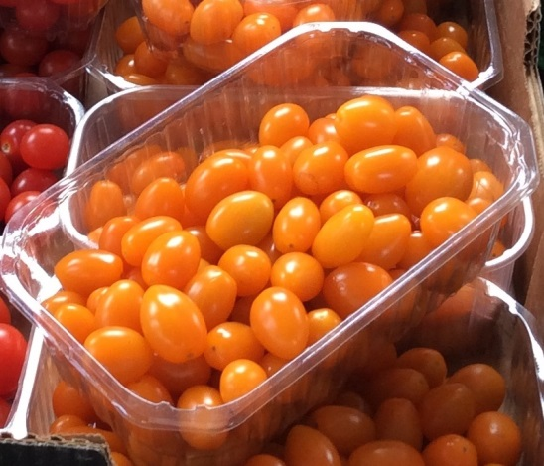
Fresh Tomatoes, their Uses and Pricing Segments
Type: Large tomatoes
Use: Fresh sliced, cooking
Pricing: Economy price
Type: Cherry (on the vine)
Use: Salads
Pricing: Mid-range price
Type: Mini, amber plum
Use: Salads and snacking
Pricing: Premium price

Slide 23
Clients within Value Chains
Different clients in value chains have different requirements and often cannot all be satisfied with the same variety, especially when there are specialist properties required for processing
Breeders should have regular contact with clients in all parts of the value chain and involve them in new variety design

Slide 24
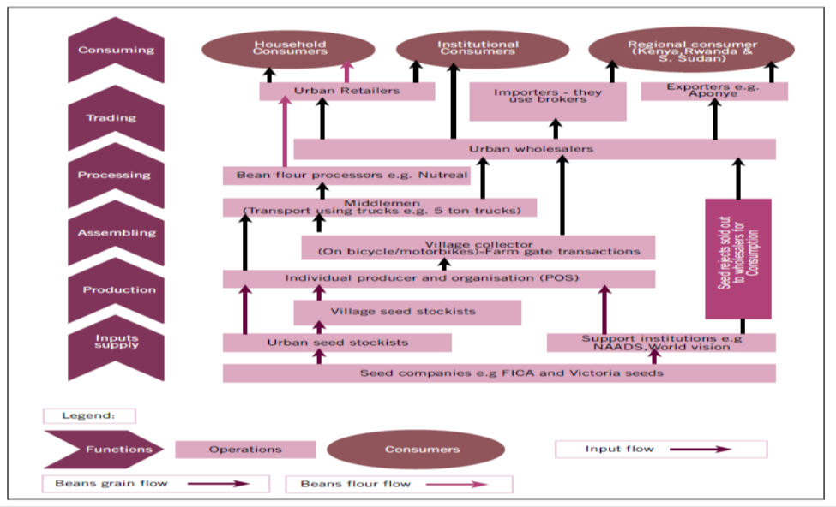
Ugandan bean value network

Slide 25
Implications for the Role of the Breeder
The business of breeding – Demand–led approaches require breeders to learn the “business of plant breeding” and be able to gather and assimilate information from multiple clients and sources within crop value chains
Partnering and collaboration – Breeders need to broaden their reach, influence and know-how beyond their technical competencies and to be able to manage collaborations and partnerships with both the public and private sectors

Slide 26
4. New variety design and product profiling
Objectives
To understand the core method of product profiling to:
- Characterize existing varieties used by farmers; and
- Identify future properties important to clients and other stakeholders along the value chain
To understand how to create new designs and set benchmarks to meet client needs
To understand how to prioritize a range of traits using demand-led approaches and make trade-off decisions
4. To translate new variety designs into a practical breeding programme with clear goals and objectives

Slide 27
New Variety Design
Target clients – Define who the new variety is targeted to serve i.e. what market segment(s)
Value chain needs – Understand clients and stakeholders along the whole targeted value chain
Crop uses – Define all uses of the crop as food, feed, energy, propagation seed or other purposes
Variety identity and descriptors – Understand every facet of the crop plant, pre and post harvest and differences between varieties

Slide 28
New Variety Design and Product Profiles
Key messages
Up-to-date qualitative and quantitative market research data on clients’ needs are essential to make decisions
A key aspect in the design (often overlooked) is the cost and feasibility of seed multiplication
To understand and create an advocacy programme with government regulators to adapt current registration requirements to include new, market-led design features that offer additional benefits to farmers and consumers

Slide 29
Client and Market Importance
The core goal for a demand-led breeder is to create a new variety that meets a client demand by either:
- Improving design features within existing varieties, - or - Providing new benefits that will increase new varietal adoption
The four main inputs required for new variety design are:
  Market research
  Variety performance
  Traits required
  Trait prioritization
Notes:
Market research - Users to have done detailed market research and understand the needs and requirements of all clients in a value chain from farmers through to consumers
Variety performance – Detailed technical knowledge of the attributes and performance of registered varieties and those that are market leaders or gaining market share
Traits required - To be able to define the list of trait characteristics required and create a performance benchmark
Trait prioritization – To be able to assess the importance of each trait in terms of uniqueness/differentiation and likelihood of being in demand by farmers/value chain and/or carry a price premium

Slide 30
What is a Product Profile?
The name given to the full range of technical attributes of a new variety with quantitative measures
Also called “ideotype” or “product specification”
The best product profiles always set a target benchmark for the required performance of each trait; by comparisons vs. the performance of existing varieties and/or expressed on a numeric or photographic scale
Trait descriptors/dictionaries are compiled and published by the CGIAR International Research Centers and national research intuitions

Slide 31
Creating a Product Profile
Trait category | No | Trait | Trait description | Variety benchmark | Performance required (=, >, >=, >>)
Crop yield | 1
 | 2
Plant architecture Seed production | 1
 | 2
Biotic stress | 1
 | 2
Abiotic stress | 1
 | 2
Crop handling, harvest, storage, transport | 1
 | 2
Value chain clients, consumers, processors | 1
 | 2

Slide 32
Priority of Traits
Important and challenging decision for every breeder
Market evaluation for each trait has two dimensions
  Differentiation
  Willingness to pay price premium
  Opportunity to grow market share
  Market demand
  % growers/area that need this trait

Slide 33
Trait Prioritization
Willingness to
pay price premium
Opportunity to grow
market share
10
Niche opportunity
8
Winning traits
6
Differentiation
4
Low potential
Essential traits
2
0
20
40
60
80
100
Market demand
% growers/area that need this trait

Slide 34
Trait Prioritization
10
Niche opportunity
Winning traits
Yield
Plant architecture
Biotic stress
Abiotic stress
Crop handling
Consumer preference
8
6
Differentiation
4
Differentiation
Willingness to
pay price premium
Opportunity to grow
market share
2
Low potential
Essential traits
0
20
40
60
80
100
Market demand
% growers/area that need this trait

Slide 35
Translating Product Profiles into Breeding Objectives
Product profile aligns with a set of measurable breeding goals and objectives
Successful demand-led variety design and development creates new varieties that are fit-for-purpose, high quality, and feasible
The breeding science and its technical and practical feasibilities depend on defined goals and objectives

Slide 36
Translating Product Profiles into Breeding Objectives
New varieties are highly innovative and require new combinations of traits
The new varieties are: Distinguishable (D), Uniform (U), Stable (S) and Novel (N) - meeting the DUSN trial requirements
Product profiles may require some revisions to increase the probability of delivery
Innovation and ease of delivery can be inversely correlated; Paradigm shifts may require supporting investigative science programmes and pre-breeding activities

Slide 37
How is Demand-led Variety Design Different from Current Practice?
Competitor product profiling - Analysis of characteristics of existing varieties and landraces and their differentiating characteristics at each stage in the value chain
New variety design – A product profile is created that contains many traits and characteristics (typically > 40) with performance benchmarks to create breeding objectives
Quantitative benchmarks – A target quantitative bench-mark for each trait for line progression to variety release
Trade-off decisions on traits – A decision process to determine final variety design that takes account of client needs, technical feasibility and fiscal considerations

Slide 38
Implications for Role of the Breeder
Variety identity – In depth understanding about the full range of characteristics that comprise each variety and landrace used by clients
Registration officials – Early dialogue with registration officials to develop a detailed understanding about the variety registration processes and requirements
Co-ordination and consultation – Greater consultation and co-ordination time and liaison skills are needed to understand the needs of clients all along the value chain
Communication skills - Demand-led breeders need to present new variety designs to a range of clients, non-technical professionals, government officials and investors

Slide 39
Challenges
In the large private sector seed industry,
  Demand-driven product design successfully introduced into productive plant breeding programmes
  Combined with excellent science and technology, development rigor and appropriate awareness campaigns with farmers and customers,
  Leads to significant gains in adoption rates and market share of new varieties

Slide 40
Challenges
The challenge is finding cost-effective ways to tailor demand-led approaches to new variety design, product profiling and success criteria into public sector and small seed company breeding programmes in developing countries
Need to harness skills and cooperation of the private sector; and better understand tropical crop value chains and market trends
Opportunities for new public and private sector partnerships to solve problems together

Slide 41
5. Variety development strategy and stage plan
Objectives
Variety development strategy and stage plan:
  To enable plant breeders to construct a high quality, well-documented demand-led breeding strategy and a development stage plan, to enable good governance, rigorous decision-making and activity planning within a demand-led breeding project
2. Stakeholder engagement:
To ensure the variety development strategy and stage plan allow for involvement of stakeholders at key decision points on:
  The design, development and release of new varieties;
  Enabling new varieties to reach farmers; and
  Provide feedback on product performance and farmer adoption

Slide 42
Variety Development Strategy
A development strategy defines the core breeding goal and creates a framework for decision-making and investment
The strategy analyses the external environment, defines problem and answers key questions on the product being developed: ‘what’, ‘why’, ‘for whom’ and ‘how’?
The strategy has a broader scope than a development plan and considers the end product and adoption. It should precede preparing the development stage plan

Slide 43
Development Stage Plan
A Stage Plan includes the following key activities:
  Development planning
  Variety design
  Breeding, testing and evaluation
  Variety registration and scale up
  Seed production
  Monitoring and evaluation – at all stages of the variety development process

Slide 44
Demand-led Breeding Stage Plan
Line progression decisions
Investment
Decision
Initiation of research on germplasm aligned to the product concept
Commercial
Candidates
selected
requiring characterization, scaling-up and regulatory approval
Product
Launch
of specific products in specific market segments
Product discontinuation
Products that have completed discontinuation activities, and stock removed from inventories
Product concept
Breeding & Selection
Product Evaluation
and Scale-up
Life Cycle Management
Variety Design
A
Discovery
B
Proof of Concept
C
Early Development
D
Late Development
E
Pre-Commercial
F
Commercial
G
Discontinue
H
Discovery
Market research.
Product profile creation.
Development Investment
case created.
Identification, characterization and selection of specific traits to be used
Line Development.
Development and screening of product components or pre-products rather than products
Small plot screening of products as commercial prototypes
Product prototype characterization and selection
based on performance in replicated trials and wider evaluation
Preparing for launch
Product sales
Launch
Rapid Growth
Peak Sales
Sales Decline
Stop sales
Elimination of inventory
Stage activities
Key
Stage
Phase
Stage Gate decision point
Modified version of
Syngenta Seeds stage plan

Slide 45
Critical Path Analysis Diagram with
Risk Dependencies
Activity
New variety breeding programme
Years
1
2
3
4
5
6
7
8
9
10+
Activity 1
Activity 2
Critical path
Activity 3
Dependency
risk
Activity 4
Activity 5
Activity 6
Activity 7
Activity 8
Activity 9
Activity 10

Slide 46
Importance of Timelines and Critical Path
  Understand the timelines and associated costs to develop and register a new variety
  Clear understanding about critical paths and approaches to risk reduction
  Develop risk mitigation strategies
  Understand costs and rewards associated with risks
  Critical path analysis and pro-active risk management will help breeding team to develop new varieties that meet farmers and value chain needs in a timely and cost-effective manner

Slide 47
Demand-led Variety Registration
Consumer traits and regulatory hurdles
Demand-led breeding is complex and can take longer- so a smooth registration process is a key factor
Regional harmonization may influence market size and subsequent investment decisions
  Demand-led variety registration may be influence by international regulations such as UPOV, breeders’ rights and national registration agencies

Slide 48
6. Monitoring, evaluation and learning
Objectives (1)
Performance benchmarking: To enable breeders to devise a realistic performance assessment plan for their demand-led breeding programme so:
(i) It is incorporated into strategies and stage plans for new variety design and engages with clients and stakeholders in the value chain;
(ii) It develops key performance indicators tailored for new variety development and delivery of a demand-led breeding programme’s goals and objectives

Slide 49
6. Monitoring, evaluation and learning
Objectives (2)
2. Variety adoption and performance tracking
To enable breeders to appreciate the importance of variety adoption assessment in demand-led breeding
To design pathways for monitoring progress in demand-led breeding with value chain clients, with defined responsibilities for the various actors
To explore improved, low cost methods for variety tracking to assess adoption of new varieties

Slide 50
Monitoring
Monitoring is a continuous observation and checking procedure on the progress of on-going breeding activities.
Compares progress of activities against milestones and timelines for decisions in the stage plan
Compares estimated and actual costs of the project against its approved budget
The purposes of monitoring are:
  To support reaching the milestones and targets set for the project in a timely manner;
  To determine if corrective action is required to solve emerging problems or any delays;
  To identify improvements that need to made to the stage plan

Slide 51
Evaluation
Four key decision points in the stage plan when critical evaluation needs to be undertaken to support investment and progression decisions, are:
Investment decision: Decision to start a breeding project and invest in creating a new variety, based on a demand-driven product profile
Commercial candidates: Deciding on lead lines to be developed and scaled up
New variety release
Post-launch adoption and impact assessment

Slide 52
How is M&E integrated into Demand- led Breeding Projects/programme?
M&E is an important component for success and continuous improvement in demand-led breeding
M&E for demand-led breeding is designed to be primarily target driven (and not breeding activity driven)
Key performance indicators of success include metrics on:
  Performance of new varieties, meeting trait specifications
  Client satisfaction
  Use of new varieties by farmers and their value chains

Slide 53
Variety Adoption and Performance Tracking
Success of a breeding programme can only be verified if the adoption pathways and performances of the products are tracked and documented
Breeders need to be aware of all variety identity and tracking technologies available e.g. phenotypic and low cost molecular approaches
Evaluate each tracking option in terms of accuracy, technical feasibility and cost
Select and incorporate the most appropriate tracking methods into the development strategy and stage plan

Slide 54
Learning and Communication
Learning is an important aspect of a breeding project that is often overlooked
Success stories/case studies are important communication tools to share learning and impacts amongst breeders, clients, investors and value chain actors
Case studies provide a medium for understanding and acting on knowledge gained and lessons learned;
Case studies provide a lasting record of the breeding team’s accomplishments and impact well beyond the completion of a specific breeding project (e.g. Norman Borlaug (wheat) and Gibesa Ejeta (sorghum) effect)
Notes:
Quantitative key performance measures – these are numerical and are gathered using e.g. surveys with set questionnaires, predefined data collection formats useful for recording and comparing predetermined variables
Qualitative descriptions – the change is shown through description. e.g. rapid assessment techniques, focus group discussions, and semi-structured interviews
Participatory methods – these include visual methods that do not rely on high literacy levels e.g. photos, diagrams, maps, timelines, stories, drama, song, mapping, ranking and scoring. These approaches allow the differences in people’s interests, needs and priorities to be recognized by insiders and outsiders, and form the basis for negotiation between stakeholders. They also allow people to benefit from analysing and asserting their own interests, and make a meaningful contribution to the way the project is designed, managed and implemented. It is a way of ensuring relevance of the project and promoting ownership of local people, which is essential for any chance of sustainability and success in the long term
Most significant change (MSC) – this is one of the most popular approaches that have been developed for monitoring and evaluation without indicators. It is a form of participatory monitoring and evaluation, based on telling stories about events people think were important and why they think they were significant. With this approach, there is no need to explain what an indicator is or learn special professional skills, so everyone can participate and the technique can be used in different cultural contexts. It is particularly suited to monitoring thea project where the focus is on learning rather than just delivery
Outcome mapping – this technique focuses on changes in the behaviour and attitudes of people, groups and organizations that are directly affected by the development or release of the new variety. E.g. outcome mapping focuses on the effect of the development project on the roles and participation of partners from the value chain for this and future projects

Slide 55
Case study
Beans in Ethiopia 2004-2014

Slide 56
7. Making the business case for investment in new variety development
Overview
Changing perception of breeding as a cost to breeding as an investment that gives a return
Plant breeding bring benefits to many people -farmers, consumers and others in value chain
Successful plant breeding brings economic, social and environmental benefits

Slide 57
Key Messages
Understanding the value and costs of investing in plant breeding is critical to success for a breeder
Detailed analysis is required on the merits of each case and the strength and degree of certainty of each assumption
When the benefits are higher than the costs, it may be worth making the investment in developing a new variety
Opportunity cost: Also consider alternative variety design, activity option or other breeding programme that could be a better investment choice for using the resources available

Slide 58
Beneficiary | Specific benefit | Benefit consequence | Benefit type | Quantification units
Farmers | Greater yield | Farmer income, Shift from subsistence farming to entering markets, Business growth, Can afford education for child | Economic | USD
 | Earlier or later cropping (than vs. main season) | Higher prices (as less supply) | Economic | USD
 | Improved crop quality | Higher price, more customers | Economic | USD
 | Improved plant architecture | Easier harvesting Time saving | Economic | USD
Seed producers | Greater seed yield, Higher productivity per area grown | Farmer income, Unit costs are less. More competitive price to distributors | Economic | USD/person hours
Transporters | Less damage in transit | Cost saving | Economic | USD
Wholesalers | Improved shelf-life | Cost saving | Economic | USD
Food processing companies | Source from local farmers rather than imports | Cost saving Reliable supply | Economic, Logistics | USD
Food retailers/ Supermarkets | Good varieties and sourcing from local smallholders | Freshness and higher prices Differentiation and fair trade brands
 | Improved shelf-life | Loss of wastage and costs
Consumers | Easier preparation | Time saving | Economic, Social | USD
 | Shorter cooking time | Energy saving | Economic Social | USD
Public investors Governments , International dev. agencies) | Deliver their mandate, Support balance of payments, Economic development, Farmer livelihoods | Economic development, Continued funding for plant breeding projects and support for innovation and science | Economic, Social | USD

Slide 59
Investment Analysis Tool
Project rationale
Financial metrics as inputs for analysis
    E.g. seed market size, projected growth, market share of new variety, gross profit on seed; total breeding costs
Outputs: Investment analysis – Performance and investment metrics
Demonstration on how to use Investment Tool

Slide 60
Further information
Persley, G J and Anthony, V M (eds) (2017). The Business of Plant breeding: Market–led approaches to new variety design in Africa. CABI Wallingford, Oxon. UK. www.cabi.org

Slide 61
The Business of Plant Breeding:
Market-led approaches to new variety design in Africa
The Business of Plant Breeding:
Market-led approaches to new variety design in Africa
Executive Summary

