Slide 1

TOURISM
PETER ROBINSON MICHAEL LÜCK STEPHEN L. J. SMITH

Slide 2
7
Accommodation

Slide 3
Learning Objectives
Critically analyse the concept of design
Critically evaluate the design of hotel room
Critically assess the relationship between price and consumer expectations
Critically evaluate the current system of accommodation quality rating in the UK

Slide 4
Design
‘The operations manager has to undertake responsibility for being involved in the design of both the end service/product and the delivery processes. This means taking responsibility for: the way in which the end product functions, the organisation of the transformation process, the technology used and the design of the jobs involved… Being involved in design is not an easy role, as the operations perspective is usually concerned with the constraints of the operation, whilst the design perspective is focused upon creativity… Bringing the creative and the operations perspectives together in a positive manner is one of the features of organisations that manage design well.’
(Galloway et al., 2000, p. 7)

Slide 5
Design
‘Design is the activity of determining the physical form, shape and composition of products, services and processes … it is crucial to the operation’s other activities’.
(Slack et al., 2004, p. 27)

Slide 6
Design
‘Products and Services are usually the first thing which customers see of a company, so they should have an impact … although operations managers often do not have direct responsibility for product and service design, they always have, at least, an indirect responsibility to provide the information and advice upon which successful product or service development depends … unless a service, however well conceived, can be implemented, the design can never bring its full benefits’ (Slack et al., 2004, p. 127)

Slide 7
Service Design
‘Services require an operating and delivery system in order to function. That system should be designed in such a way as to offer effective customer service through an efficiently operated process.’
(Mudie and Cottam, 1999, p. 44)

Slide 8
Design – A Competitive Advantage?
‘The objective of designing products and services is to satisfy customers by meeting their actual or anticipated needs and expectations. This, in turn, enhances the competitiveness of the organisation. Product and service design, therefore, can be seen as starting and ending with the customer.’
(Slack et al., 2004, p. 129)

Slide 9
Design – A Competitive Advantage?
The customer–marketing–design feedback loop
(Slack et al., 2004, p. 130)
Marketing
Interpretation of
Expectations
Expectations
Product/service
design
Operations
Customer
Product/service
specification
Product/service

Slide 10
General Service Design
Customer contact (how much and what will the nature of the contact be?)
Service mix (e.g. outdoor and indoor sports, adventure sports, leisure activities – art galleries, theatres, museums, parks etc.)
Location
Design of service facility (layout, furnishing, uniforms, signs etc.)
Technology
Employees (how many? Ratio of f/t and p/t? Back-office and front-office? Skills?
Organisation structure (Finance, Personnel, Operations, Marketing etc.)
Information (that needed for running the organization, how it will be stored, who has access)
Demand and supply management (how flexible is capacity for meeting demand fluctuations)
Procedures (standardized or customized)
Control (systems for the smooth running of the organization)
(Mudie and Cottam, 1999)

Slide 11
Designing the Service Setting
(from Mudie and Cottam, 1999)
Design of service setting may affect customer feelings and responses
Matter of taste and perception
Organizations must develop understanding of how customers respond to layout, furnishings, colour, light etc.
A main objective would be to determine the relationship between environmental conditions and behavioural outcomes – why?

Slide 12
Designing the Service Setting
(from Mudie and Cottam, 1999)
When planning the design of a service setting, providers should consider
  Environmental stimuli (ambience, space, signs etc.)
  Beliefs and feelings
    (emotional, physiological)
  Responses
    (approach, avoid)

Slide 13
Bedroom Design
Katsigiris and Thomas (1999) define design as ‘the definition of sizes, shapes, styles and decorations’ and suggest that design is important in both ‘soft’ and ‘hard’ ways

Slide 14
Bedroom Design
Soft factors
Harder factors
Good design can affect ‘soft’ factors including:
  image
  style
  comfort
  marketing
  ambience
operational efficiency
cost
safety
cleanability and maintenance
ergonomics
noise
space allocation

Slide 15
Hotel Bedrooms (2)
How
What
Size
Materials
Finishes
Hygiene
Carpets/floor coverings
Fabrics
Soft furnishings
En-Suite
Sanitary facilities
Furniture
Mini bar
Room service
Coffee/tea making (other)
Electronics (TV, plasma screen, CD player, games console, Internet access)
Bath/shower/bidet
Toiletries, towels, bathmats, (other)

Slide 16
Price and Expectation
Tariffs
  Rack rate
  Discounts
Yield Management
the process of frequently adjusting the price of a product in response to various market factors, such as demand or competition
Staffing and equipment

Slide 17
Applied Design
Theme
Location
History
Authenticity
Quality standards
Service quality
Atmosphere
Sense and relaxation
Remember Design from Operations Management!

Slide 18
Hotel Design
Consider
Corridors
Reception
Signage
Health and safety
Pets
Kitchen design
Ventilation
Air conditioning
Changing rooms
Leisure facilities
Access/egress/circulation
Sustainability

Slide 19
Bedroom Design
Design
Specification
Beds
Television
Tea/coffee tray
Table
Chairs
Internet access?
Mirror
Pictures
Colours
Linen
Flexibility
Specification
Trouser press
Wardrobe?
Easy to clean
Quick to clean
Low maintenance costs
Good quality
Star rated
Customer feedback
Well maintained
Easy to replace/maintain
Bathroom
  Clean colours
  Visible cleanliness
  Shower and bath
  Powerful shower

Slide 20
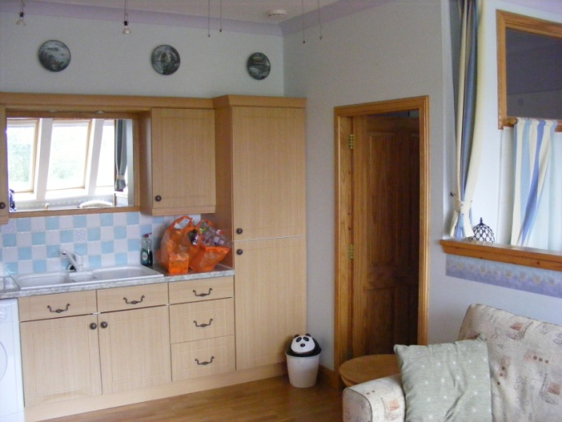
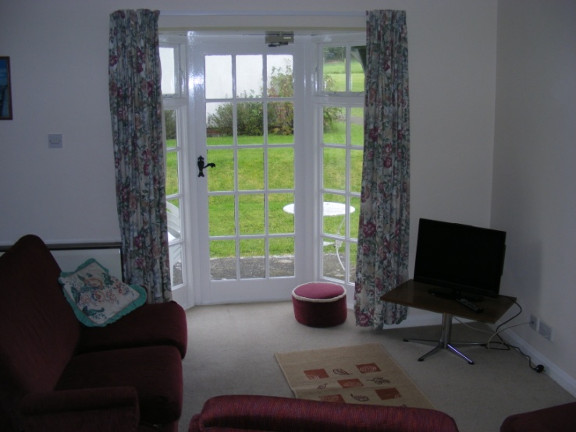
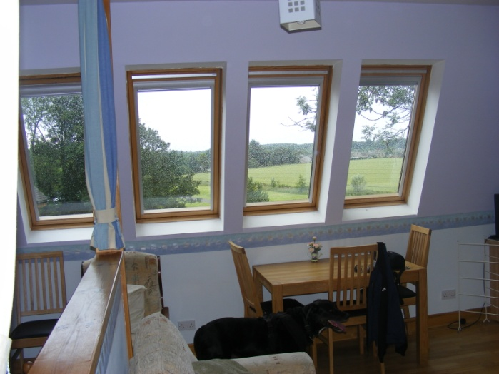

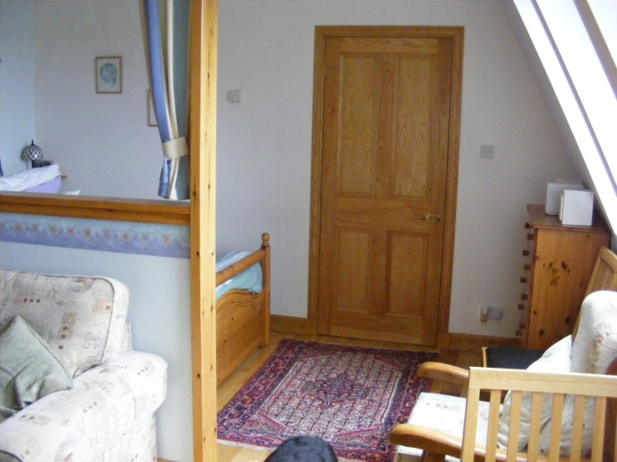
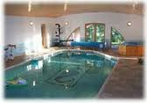
Self-Catering Design

Slide 21
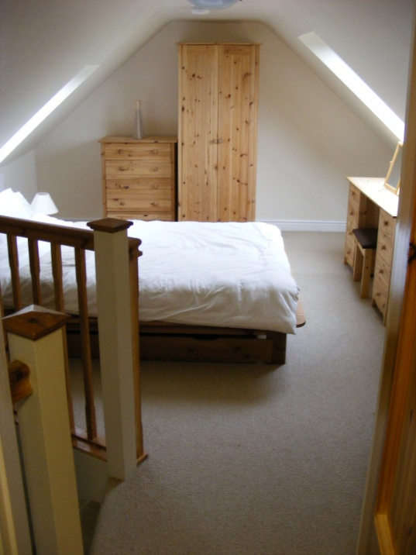
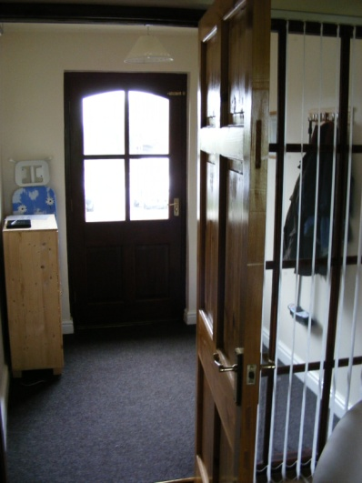
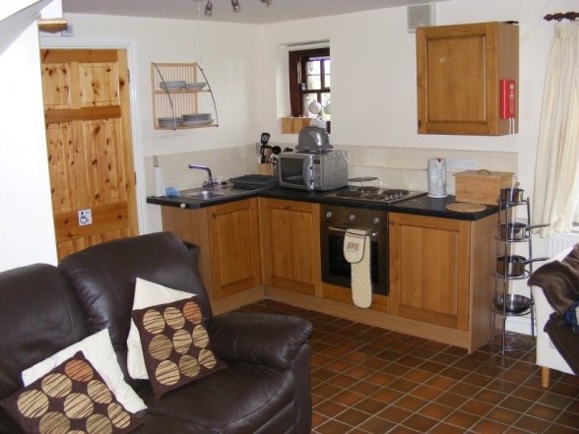

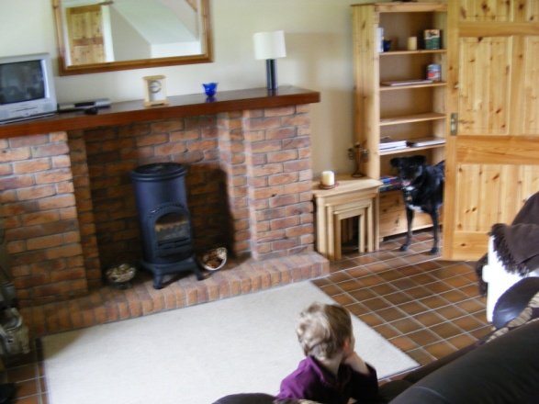
Best Practice

Slide 22
Yes or No?
Dried flowers
Plants
Plastic plants
Patterned carpets
White carpets
Wardrobe
Trouser press
Large mirrors in the bathroom
Magazines and bedroom browsers
Window brackets
Balcony
Pictures
Blankets and eiderdowns
Candles
Ironing board and iron
Bath
Net curtains
CRT TV
Books
Games (electronic?)

Slide 23
Activity 1
In groups, consider the best and worst design features in hotels and other accommodation you have stayed in
Present your Top 3 and Worst 3 to the rest of the group!

Slide 24
Activity 2
Using the flipchart paper provided, design your dream hotel room
What would it look like, what facilities and services would be on offer?

Slide 25
Quality Rating Systems:
World Rating System
European Rating System (HOTREC) attempted but differences exist: e.g.
  Some countries have rating by a single public standard – Belgium, Denmark, Greece, Italy, Malta, the Netherlands, Portugal, Spain and Hungary have laws defining the hotel rating. In Germany, Austria and Switzerland the rating is defined by the respective hotel industry association using a 5-star system – the German classifications are Tourist (*), Standard (**), Comfort (***), First Class (****) and Lexus (*****), with the mark Superior to flag extras beyond the minimum defined in the standard. This system has influenced the European Hotelstars rating system
  In France, the rating is defined by the public tourist board of the department using a 4-star system (plus ‘L’ for Luxus), which has changed to a 5-star system from 2009.
In South Africa and Namibia, the Tourist Grading Council of South Africa has strict rules for hotel types, granting up to 5 stars
UK through VisitBritain:
  2007 agreement reached
  National Quality Assurance Standards
  January 2008 implementation began
  AA Grading Scheme
Academic debates using Google Scholar; also good Mintel Reports on hotels

Slide 26
Conclusions
Hotel bedroom design is dependent on the end user
Rack rate price charged relates to complex calculations on bedroom capital cost, consumer demand discounting techniques
Quality assessments are based on design aspects (soft furnishings, quality of beds)
Bedroom includes all ancillary products
Need to see, hear, feel the product – many hotel chains now offering the ‘sleep test’
A complex aspect of managing the accommodation sector

Slide 27
References
Galloway, L., Rowbotham, F. and Azhashemi, M. (2000) Operations Management in Context. Butterworth, Oxford.
Mudie, P. and Cottam, A. (1999) The Management and Marketing of Services, 2nd edn. Butterworth-Heinemann, Oxford.
Slack, N., Chambers, S. and Johnston, R. (2004) Operations Management, 4th edn. Pearson Education Limited, Harlow, UK.

