Slide 1
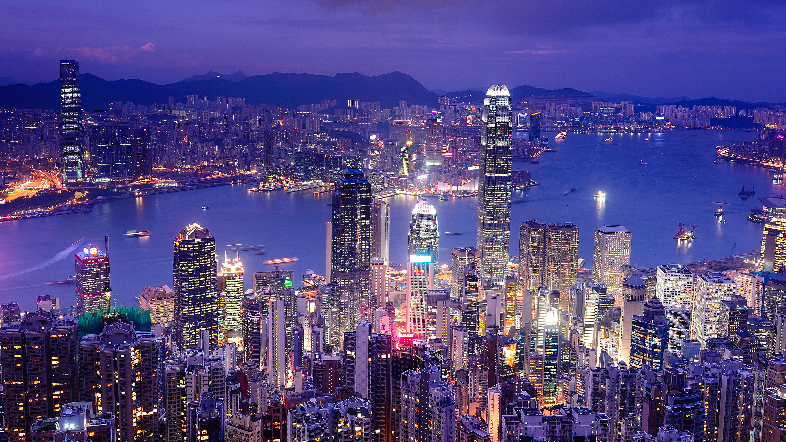
TOURISM
PETER ROBINSON MICHAEL LÜCK STEPHEN L. J. SMITH

Slide 2
16
Tourism and Sustainability

Slide 3
Learning Objectives
To understand the various forms of tourism resources
To comprehend the concept of carrying capacity
To understand the nature of economic, socio-cultural and environmental impacts
To discuss the concepts of sustainability and sustainable tourism
To understand management techniques for sustainable tourism use of resources

Slide 4
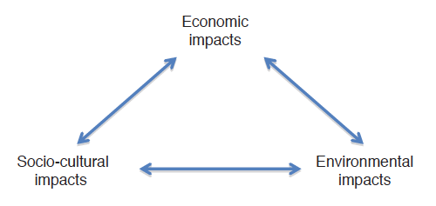
The Interrelationship
of Tourism Impacts

Slide 5
Resources
Category | Type | Examples
Natural resources | Flora, landscape, fauna, climate, water | Forests, beaches, wildlife, seasons, sea
Cultural resources | Religious, heritage, other | Churches, temples, historic buildings, ethnic celebrations
Event resources | Festivals, tournaments, business, other | Music, art, sport, trade shows, conferences, carnivals
Activity resources | Recreational, services, facilities | Golf courses, swimming pools, museums, theatres, zoos, theme parks
Services (tourism infrastructure) | Transport, accommodation, reception, catering, services | Airports, hotels, tourist information network, maps, guides, bars, restaurants, marinas, foreign exchange services

Slide 6
Carrying Capacity
Physical carrying capacity
Ecological or biological carrying capacity
Psychological carrying capacity
Social carrying capacity

Slide 7
Doxey’s Irridex
Investigates social carrying capacity from a host community viewpoint
Stages
  Euphoria
  Apathy
  Irritation/annoyance
  Antagonism

Slide 8
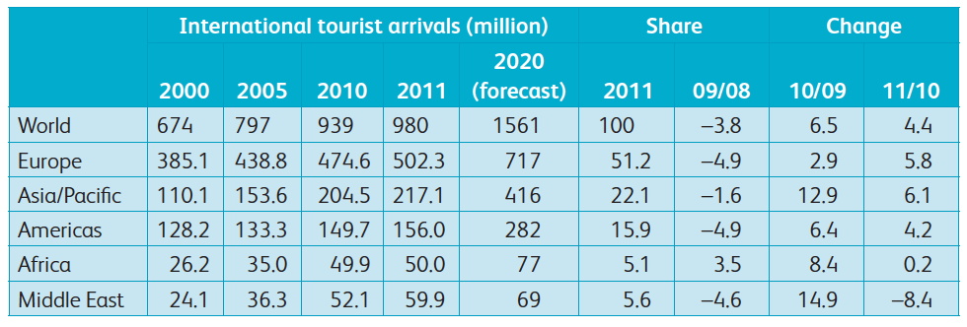
International Tourist Arrivals (UNWTO 2011, 2012)

Slide 9
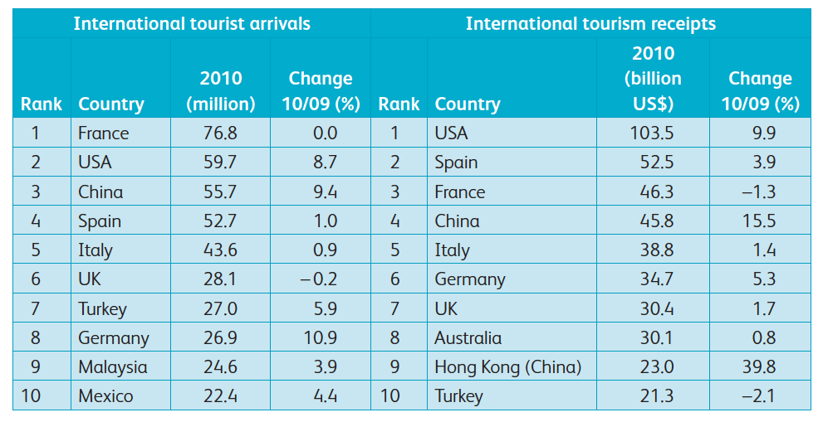
International Arrivals and
Tourism Receipts
(UNWTO, 2011)

Slide 10
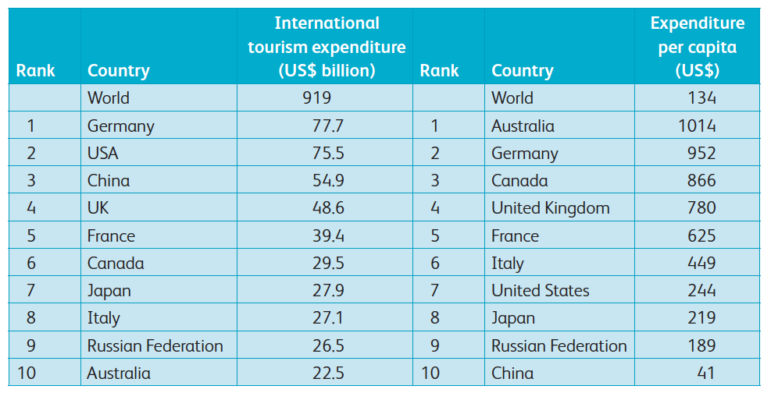
International Tourism
Expenditure
(UNWTO, 2011)

Slide 11
Socio-Cultural Impacts
Tourist types (Smith, 1989)
  Explorer
  Elite
  Off-beat
  Unusual
  Incipient mass
  Mass
  Charter

Slide 12
Plog’s Typologies
Psychocentric
Near psychocentric
Midcentric
Near allocentric
Allocentric

Slide 13
Key Social and Cultural Impacts
Authenticity (lack of)
Cultural pride
Demonstration effect
Education
Crime

Slide 14
Key Environmental Impacts
Pollution
  Noise, land, air, water
Heavy and over-use of natural resources
Environmental degradation
Wildlife disturbance
Education/awareness raising
Funding
Volunteer tourism programmes

Slide 15
Sustainability
Traditional worldview (Dominant Social Paradigm)
  A belief in limitless resources, continuous progress and the necessity of growth
  Faith in the problem-solving abilities of science and technology
  Strong emotional commitment to a laissez-faire economy and the sanctity of private property rights

Slide 16
Sustainable Tourism Development (STD)
Meet the needs and wants of the local host community in terms of improved living standards and quality of life
Satisfy the demands of tourists and the tourism industry, and continue to attract them in order to meet the first aim
Safeguard the environmental resources base for tourism, encompassing natural, built and cultural components, in order to achieve both preceding aims

Slide 17
Management Strategies
Tourism resource audit
Environmental impact assessment
Indirect management techniques
Physical alterations
Information dispersal
Eligibility requirements

Slide 18
Management Strategies
Direct management techniques
  Increased enforcement
  Zoning
  Rationing of intensity
  Restrictions on activities

Slide 19
References
UNWTO (2011) Tourism Highlights. UNWTO, Madrid.
UNWTO (2012b) Tourism 2020 Vision. Available at: http://www.unwto.org/facts/eng/vision.htm (accessed on 17 July 2011).
Smith , V.L. (1989) Hosts and Guests: The Anthropology of Tourism, 3rd edn. University of Pennsylvania Press, Philadelphia.

